Slide 1
Smart Indoor 3D Mapping

Slide 2
INDOOR 3D MAP HAS BROAD PROSPECT
Indoor GIS based on 3D map has broad prospect on many industries such as shopping mall marketing, fire fighting plan, facility management, construction supervision.
The idea is digitalizing the indoor environment and provide service to clients to enhance their abilities on managing facility, making emergency response plan, marketing indoor space.

Slide 3
INDOOR 3D MAPPING
The system must meets following requirement so that a large-scale application could be possible:
1. Economical
2. Efficient
3. Accurate
4. User friendly

Slide 4
A SUILTABLE SOLUTION
Data Collection Device:
Based on robotic operation system;
Multiple sensors;
Graphical interfaces;
Automatic data processing
Provide service to client by SaaS:
Minimum data transmission load;
Front end system based on H5 ,three js and panoramagram;
WYSIWYG feature.

Slide 5
DEMONSTRATION – DATA COLLECTION

Slide 6
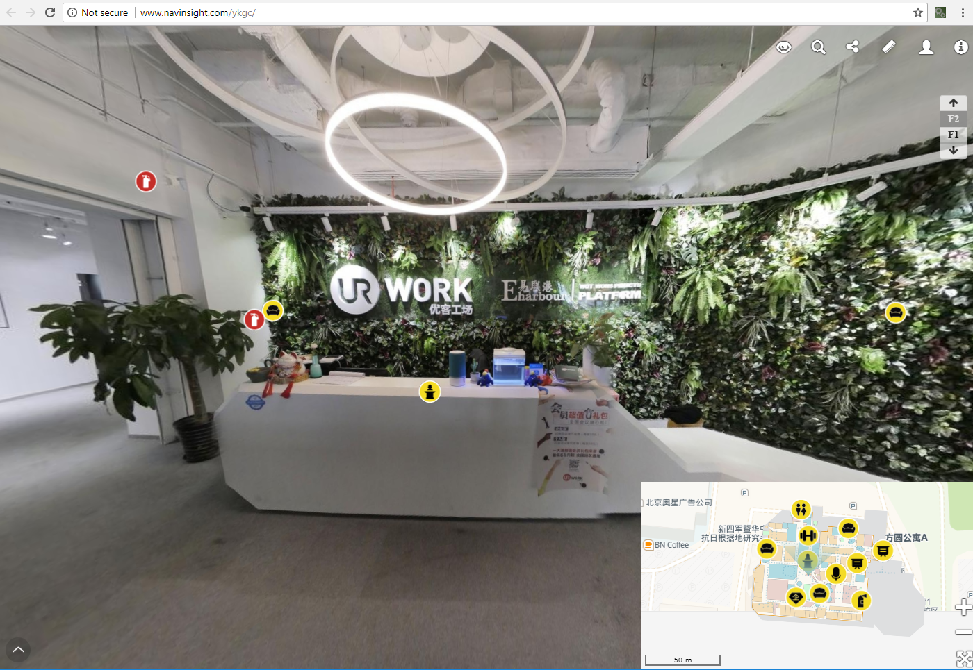
DEMONSTRATION - FRONT END
Please visit http://www.navinsight.com/ykgc/ for Demonstration

Slide 7
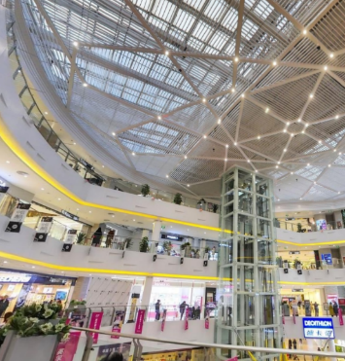
SAMPLE CASE – SHOPPING MALL MARKETING
Save much labor cost.
Show the entire indoor environment to potential commercial tenant by a link.
Implant marketing information per client’s requirements.

Slide 8
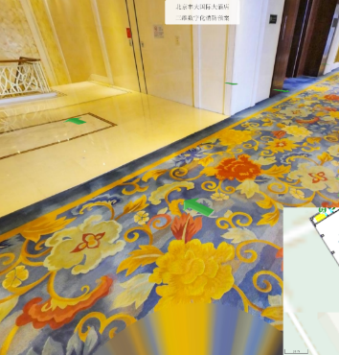
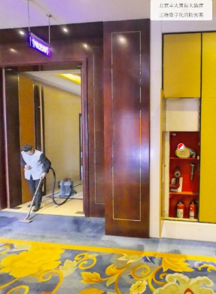
SAMPLE CASE – FIRE EMERGENCY PLAN
Label fire fighting devices by POI.
Mark attacking line or evacuating rout on panoramagram and flour plan.
Demonstrate the actual indoor environment by panoramagram.

Slide 9
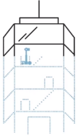
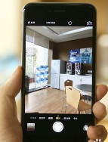
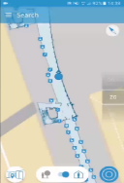
WILL HAPPEN– LOCALIZATION BY PHOTO
Step：1
Scan the building
Step：2
Take a photo in the scanned building
Step：3
Return the location
In any building that has been scanned, it will be automatically located where a photo has been taken.
Client does not have to maintain any hardware.
Deep learning will enhance the accuracy and efficiency.

Slide 10
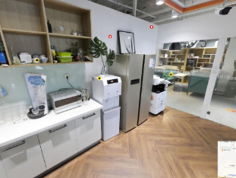
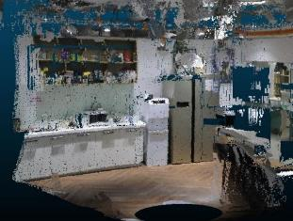
WILL HAPPEN– COLOUR POINT CLOUD
Colour point cloud, a real 3D world will replace the panoramagram.
Colour point cloud provides a more freely interactive experience.

Slide 11
Thanks
领航视觉 Navinsight
室内三维地图解决方案
Indoor 3D Mapping Solution

