Slide 1
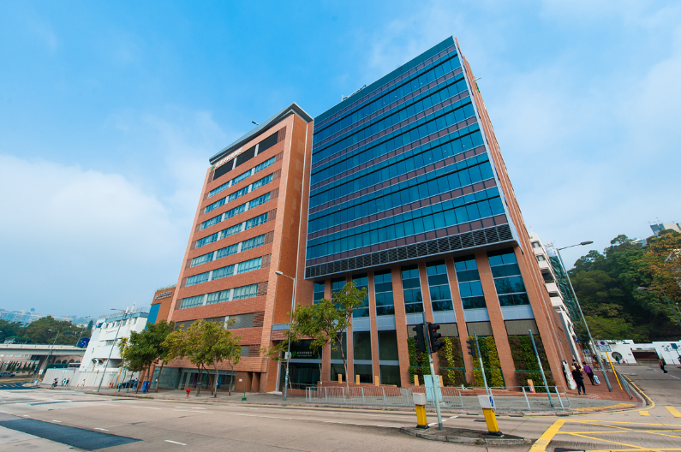


Application of High Efficiency Chillers in Hong Kong Baptist Hospital

Slide 2

Introduction
Hong Kong’s History- Air Conditioning System
B. Background of Hong Kong Baptist Hospital
C. Retro-commissioning Plan
1. Replacement of Oil free chillers at Hong
Kong Baptist Hospital
2. Combination of Chiller Plant at Block DE
3. Interconnection of Chiller Plant at Block AB

Slide 3
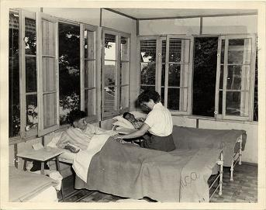
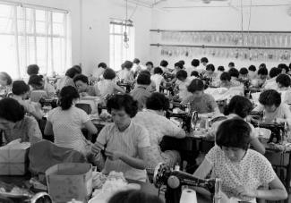
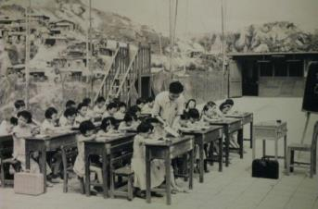


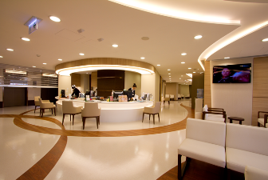
Hong Kong’s History- Air Conditioning System
1960s
Working Place
Classroom
Hospital
2000s

Slide 4
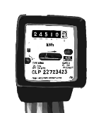
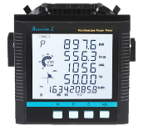
Electricity Consumption in Hong Kong
Commercial Building
1970s
Summer Time
2017 157,216 TJ
2010 150,307 TJ
Terajoule
2000 130,350 TJ
2000s
1990 85,553 TJ
1980 39,186 TJ
1970 15,950 TJ
Month
Information Source: Census and Statistics Department

Slide 5


Hong Kong’s Climate Action Plan 2030+
Information Source: Environmental Bureau

Slide 6

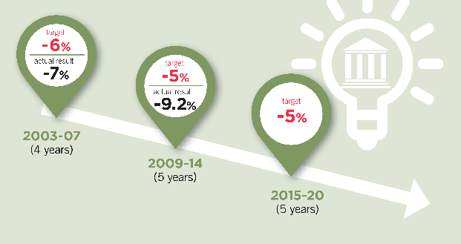
Energy Saving Plan for Hong Kong’s Built Environment (2015 – 2025 +)
Energy Saving Timeline for Government Buildings
(2013/14 data as baseline)
Information Source: Environmental Bureau

Slide 7
Retro-commissioning
“Retro-commissioning” is one of the key initiatives to promote energy saving for existing building.
Retro-commissioning (RCx) is a systematic process to periodically check an existing building’s performance to identify operational improvements that can save energy and thus lower energy bills and improve indoor environment.
Information Source: EMSD

Slide 8


Background
Hong Kong Baptist Hospital

Slide 9
Hospital Development
Block D
Block E
Block C
Block B
Block A
Block A
Block B
Block C
Waterloo Road
Heart Centre
Out-patient Centre
Specialist Centre
Pathology
ICU
Cardiac Catheterization Lab
Radiology
Specialist Centre
Pathology
Molecular Pathology Laboratory
Pharmacy
Radiotherapy
Oncology Centre
OT
Skin & Laser Centre
ENT Centre
Eye Centre
Kam Shing Road
MRI Centre
Nuclear Medicine & PET Centre
257 Beds
Block D
Block E
320 Beds
111 Beds
94 Beds
102 Beds
Junction Road
1982
2008
2015
1963
1979

Slide 10
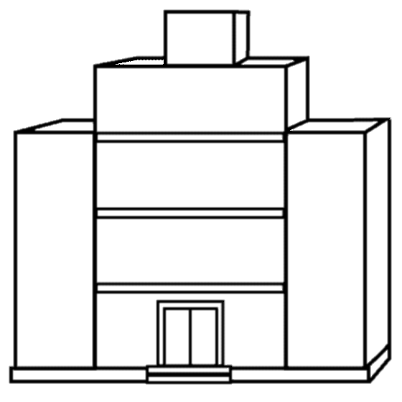
Energy Use in Private Hospital

Slide 11
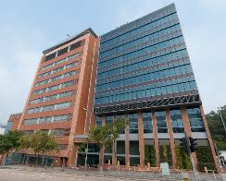
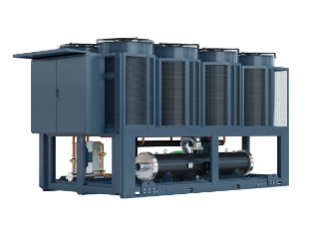
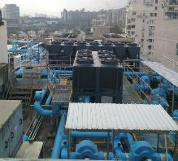
Retro-commissioning Planning
2013
Replacement of Total 16 nos. Oil free chillers
2015
Combination of Chiller Plant at Block DE
2017
Interconnection of Chiller Plant at Block AB

Slide 12
1. Replacement of Oil free chillers at Hong Kong Baptist Hospital

Slide 13
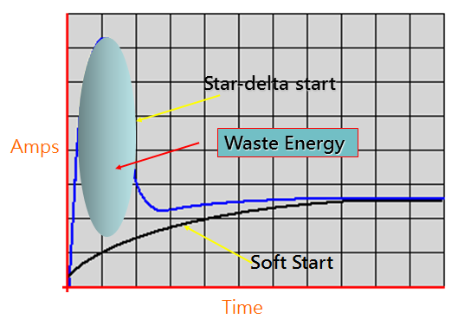

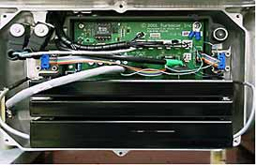
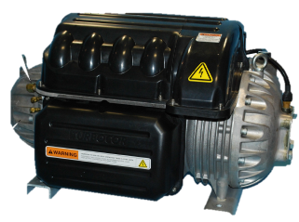
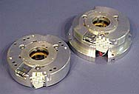

Oil free Chiller
1.
Oil Free Chiller
Soft Starter
2.
Radial bearings
Radial bearings
Motor rotor
Impellers
Magnetic Bearing System
Motor
Axial bearing
Oil Free Magnetic Centrifugal Compressor
Position sensor ring
13
Position Sensor ring

Slide 14

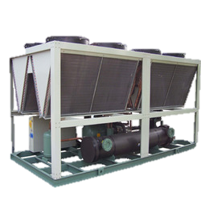
Electricity Saving for Selection of Chiller
IPLV | Oil free chiller | Air cool chiller
A. 25% | 7.8 | 2.25
B. 50% | 5.8 | 3.53
C. 75% | 4.6 | 2.63
D.100% | 3.3 | 2.09
 | 5.51 | 2.98
COP
Oil free Chiller
Air cool Chiller
10 20 30 40 50 60 70 80 90 100
Cooling Capacity (%)

Slide 15


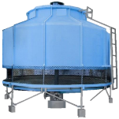


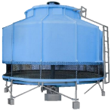
Consideration on Replacement of Chillers
1. High energy efficiency
Air Cool Chiller
Air Cool Oil free Chiller
Water Cool Chiller
Need Improvement | Good | Excellent
COP
2.5 to 3.5
3.5 to 5
5 to 7
2. Maintenance Cost
Water Cool Chiller
Air Cool Chiller
Air Cool Oil free Chiller
High | Medium | Low

Slide 16
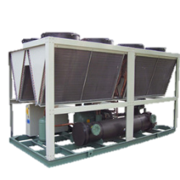
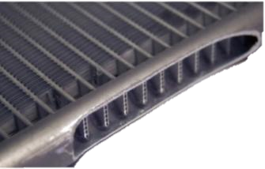
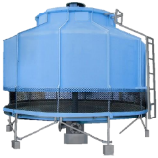
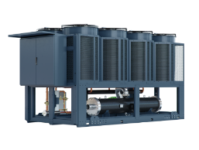


Consideration on Replacement of Chillers
3. Weight
(Building Structure)
Micro Channel
Air Cool Chiller
Air Cool Oil free Chiller
Water Cool Chiller
Heavy | Medium | Light
4. Noise
Air Cool Chiller
Air Cool Oil free Chiller
Water Cool Chiller
Noisy | Fair | Quiet

Slide 17

Replacement of Oil free Chillers
First Stage Analysis
Second Stage Analysis
2014
Chiller B1
Chiller B2
2015
Chiller A1
2016
2017
Chiller B3,B4,B5
Chiller C1,C2, C3
Chiller M3
2018-2019
Chiller A3
Chiller B6
Chiller M1
Chiller M4
Chiller A2
Chiller A4
(2 Chillers, 1100 kW)
(7 Chillers, 4000 kW)
(3 Chillers , 2150 kW)
(2 Chillers, 580 kW)
(2 Chillers, 880 kW)
Building | Block A | Block B | Block Bext | Block C | Total
No. of Chiller | 4 | 6 | 3 | 3 | 16
kW | 1980 | 3130 | 2130 | 1800 | 9040

Slide 18
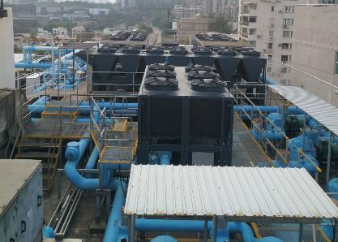
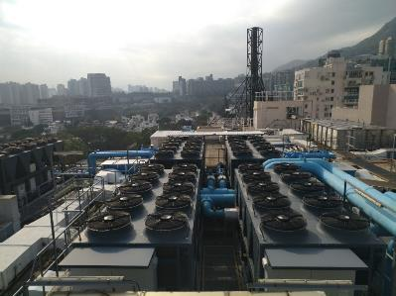
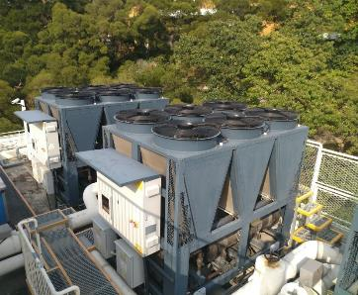
Replacement of Oil free Chillers
Block A
Block B
Block C

Slide 19
Energy Saving of Replacement of Oil free Chillers at Block B and C
2012 Baseline - 4,997,975 kWh
2017 - 3,721,332 kWh
2016 – 3,565,734 kWh
Energy Saving
(Record by CLP meter)
2012 Vs 2016
1,432,000 kWh
2012 Vs 2017
1,276,000 kWh
2,708,000 kWh

Slide 20

Energy Saving for Chiller Plant at Block BC
Year | Saving | Saving (%) | kWh /Usable floor Area (m²)
2012 | Baseline | Baseline | 488
2013 | Renovation works for C7 and C8 and 2 nos. of chillers at Block B were completed.
2014
2015 | Replacement of 9 nos. of chillers at Block B and C were completed.
2016 | 1,432,000 kWh | 28.7 % | 349
2017 | 1,276,000 kWh | 25.5 % | 364

Slide 21
2. Combination of Chiller Plant at Block DE

Slide 22
Electricity Saving of Combination of Chiller Plant at Block DE
Separate Two Chiller Plant for Block D and Block E
Electricity Consumption
Combination of One Chiller Plant for Block D and Block E
Month

Slide 23
Combination of Chiller Plant at Block DE
Block D
Block E
Block D
Block E
Chiller
Chiller
Chiller
Chiller
Future
Expansion
Redevelopment
Chiller
2015
Chiller
Chiller
3 Nos. 600kW Screw Chillers
4 Nos.1100kW Oil Free Chillers

Slide 24
Electricity Saving of Combination of Chiller Plant at Block D
2013 Baseline
kWh
2017
Energy Saving
(Record by CLP meter)
2,249,000 kWh
2013 Vs 2017
Notes:
According to CLP online meter, the electricity consumption at Block D was reduced from 5,796,835 kWh in 2013 to 3,547,403 kWh in 2017. Therefore, the annual saving in 2017 was $2,249,000 in tariff .

Slide 25
Electricity Saving of Combination of Chiller Plant at Block DE
 | Configuration | Total Cooling Capacity | Energy Saving for Combination of Chiller Plant at Block DE
 |  |  | 2013 (kWh) | 2017 (kWh) | Electricity Consumption for Chiller Plant (kWh)
Chiller Plant at Block D | 3 Nos. 600kW Screw Chillers | 1800kW | 5,796,835 | 3,547,403 | 2,249,432 by CLP Meter Record
Chiller Plant at Block E | 4 Nos. 1100kW Oil free Chillers | 4400kW | Redevelopment | 6,794,764 | Assumption by Calculation: 4 Nos. X 800 kW Screw type chillers for Block E = 2,181,362
 |  |  |  |  | Separate Two Chiller Plant for Block DE = 2,249,432+2,181,362 = 4,430,794 Actual Chillers Block DE at by BMS Record = 3,397,382 Total Saving = 4,430,794 - 3,397,382 = 1,033,422kWh

Slide 26
3. Interconnection of Chiller Plant at Block AB

Slide 27
Electricity Saving for Optimal Cooling Load for Switching Chillers
Optimal Cooling Load Level for Switching On/Off Chillers and Associate Equipment
2 Chillers + 2 Pumps
Total Power Demand
1 Chiller + 1 Pump
Building Load

Slide 28
Interconnection of Chiller Plant at Block AB
Block A
Block B
Summer Mode
Chiller
Chiller
Chiller
Chiller
Chiller
Chiller
Chiller
Chiller
To Air Side Equipment
Chiller
To Air Side Equipment
2 Nos. 550kW Oil free Chillers
1 Nos. 680kW Oil free Chillers
1 Nos. 200kW Oil free Chillers
5 Nos. 550kW Oil free Chillers

Slide 29
Interconnection of Chiller Plant at Block AB
Block A
Block B
Winter Mode/
Emergency Mode
Chiller
Chiller
Chiller
Chiller
Chiller
Chiller
Chiller
Chiller
To Air Side Equipment
Chiller
To Air Side Equipment
2 Nos. 550kW Oil free Chillers
1 Nos. 680kW Oil free Chillers
1 Nos. 200kW Oil free Chillers
5 Nos. 550kW Oil free Chillers

Slide 30
Interconnection of Chiller Plant at Block AB
Control Logic
1. Total Cooling load of Block A and B < 80% Total Capacity of Chiller Plant B 2. Outdoor temperature is lower than 18ºC
Shut down Chiller Plant A
Open one pair of inter connecting valve
Chilled Water Plant Supply by Block B
Keep on 30 mins
Plant B
Plant A
New chilled water supply and return pipes to interconnect two chiller plants

Slide 31
Energy Saving of Interconnection of Chiller Plant at Block AB
 | Configuration | Total Cooling Capacity | Building load | Energy Saving for Interconnection at Block AB in Winter Season
 |  |  |  | Existing Arrangement | New Arrangement | Electricity Consumption
Chiller Plant at Block A | 1 Nos. 680kW and 200 kW Oil Free Chillers 2 Nos. 550kW Oil free Chillers | 1080kW | Summer: 864kW Winter: 250kW | 1 X 550kW Oil free Chillers 1 X Chilled Water Pump | Interconnection at Block AB was put in operation. | (106kW + 7.5 kW) X24 X 20 days X 3 months* = 163,440 kWh
Chiller Plant at Block B | 5 Nos. 550kW Oil free Chillers | 2750kW | Summer: 2200kW Winter: 800kW | 2 X 550kW Oil free Chillers 2 X Chilled Water Pump | 2 X 550kW Oil free Chillers 2 X Chilled Water Pump | Nil
Remark: Outdoor temperature is lower than 18ºC in the winter season.

Slide 32

Benefits
A. Combination of Chiller Plant at Block DE
B. Interconnection of Chiller Plant at Block AB
1. Reduce Noise Pollution
4. Reduce Maintenance Cost
5. Improve Reliability and Flexibility
2.Energy Saving
3. Reduce Green House Gas Emission
6. Improve Building Space Utilisation

Slide 33

Electricity Consumption for Hong Kong Baptist Hospital in 2012 and 2017
Year | kWh | HK$ * | Indirect GHG emission in tonnes of CO2 equivalent
Block ABC
2012 | 20,199,960 | 20,805,959 | 11,716
2017 | 18,583,207 | 19,140,703 | 10,034
Saving | 1,616,753 | 1,665,256 | 1,682
Block DE
2013 | 4,430,792 | 4,563,716 | 2,792
2017 | 3,397,382 | 3,499,303 | 1,835
Saving | 1,033,422 | 1,064,412 | 957
Total | 2,650,175 | 2,729,668 | 2,639
114,000 Trees
Based on $1.03/kWh in 2017 for reference only.

Slide 34


Appreciation
CLP Green Plus Award
Public Organization & Utility Group
BEAM Plus Award (Block E)
(New Building V1.1)
Gold Award in 2016
Bronze Award in 2017

Slide 35






Mission
Sustainable
Hospital

Slide 36


Role of Engineer/ Facilities Manager
Get commitment
Understand
Plan & Organize
Implement
Control & Monitor
Feedback
Engineers / Facilities Manager can save the World.

Slide 37




