Slide 1
Electronically Commutated (EC) Motor Plug Fan Technology and Application

Slide 2
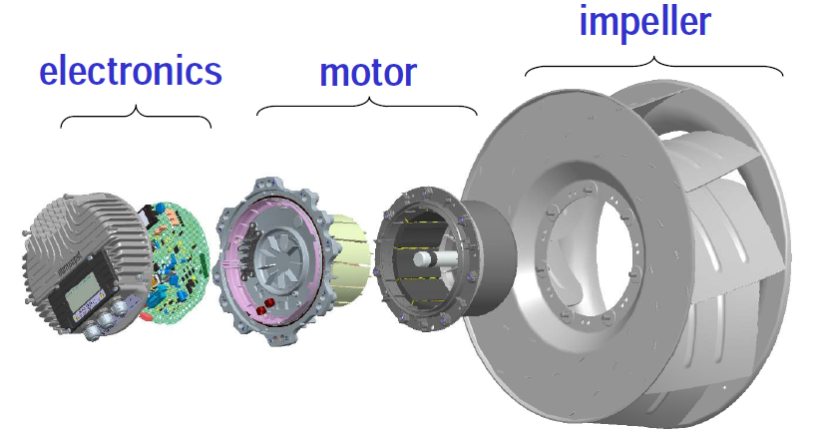
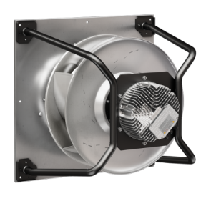
EC Fan Basics

Slide 3
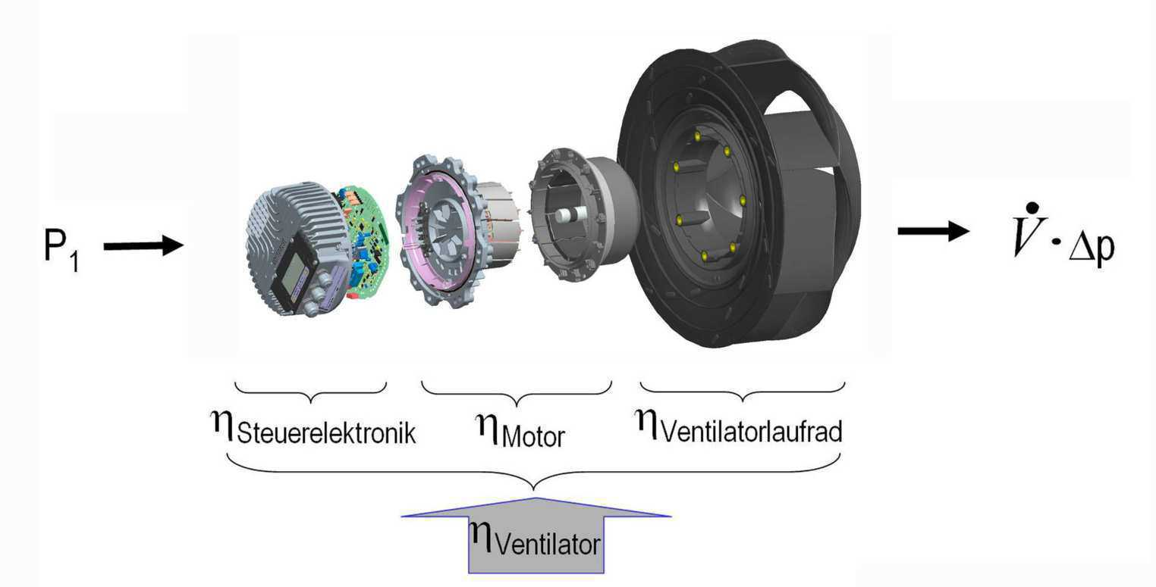
P_{ed}
q_{V}  p_{sf}
Controller
Motor
Impeller
η_{Fan}

Slide 4
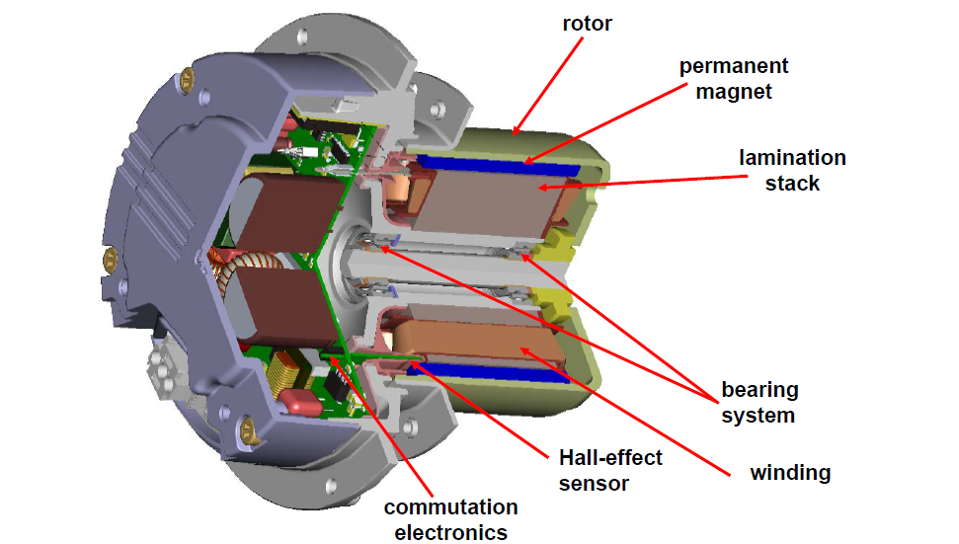
Electronically commutated motor with integrated electronics

Slide 5
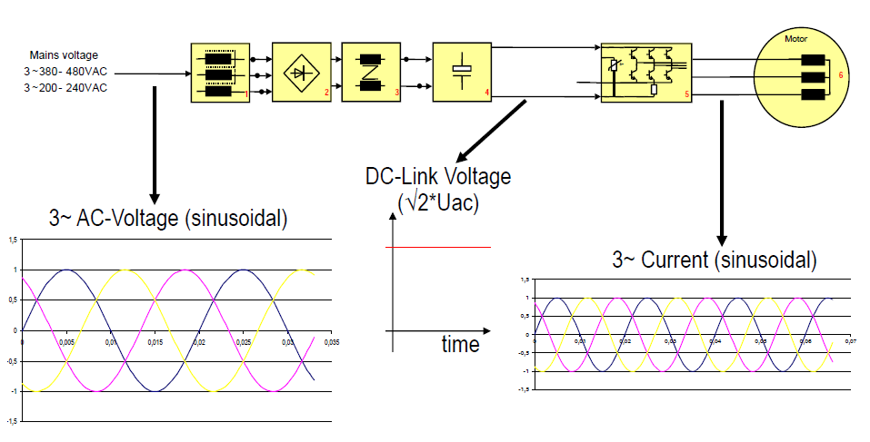
Commutation

Slide 6
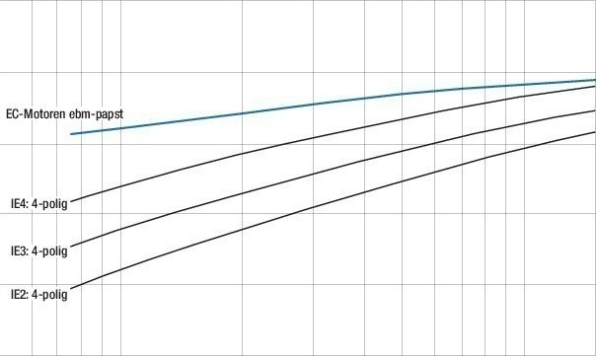
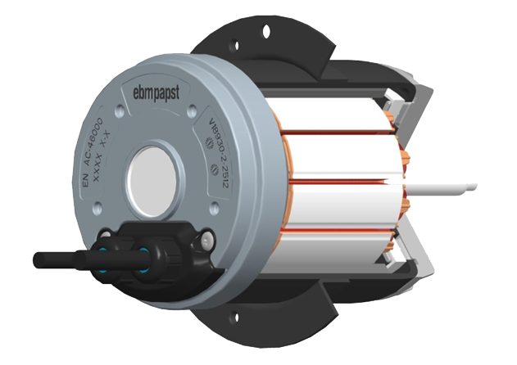
EC Motor: Efficiency level
Low heat losses
EC motors exceed efficiency class IE4
Hysteresis
No slip losses thanks to synchronous running
*50 Hz, according to IEC 60034-30
6

Slide 7
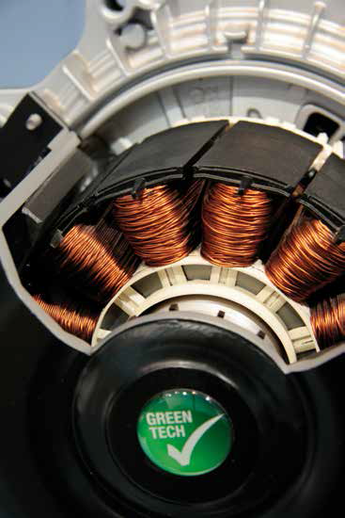
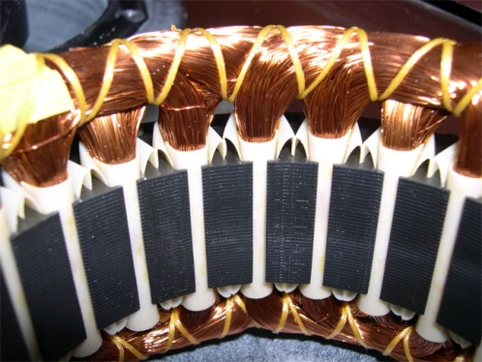
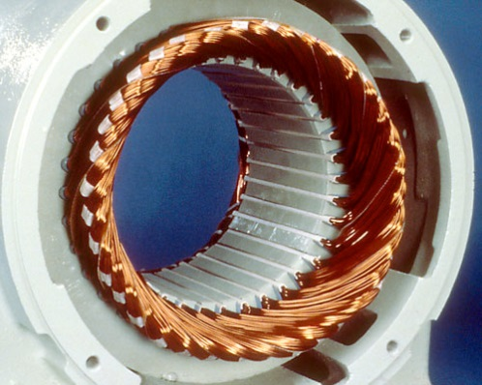
EC Motor
Motor design EC Vs AC
Permanent magnets
AC Motor wiring use more Copper
ONE Teeth wiring
EC Motor
AC Motor

Slide 8
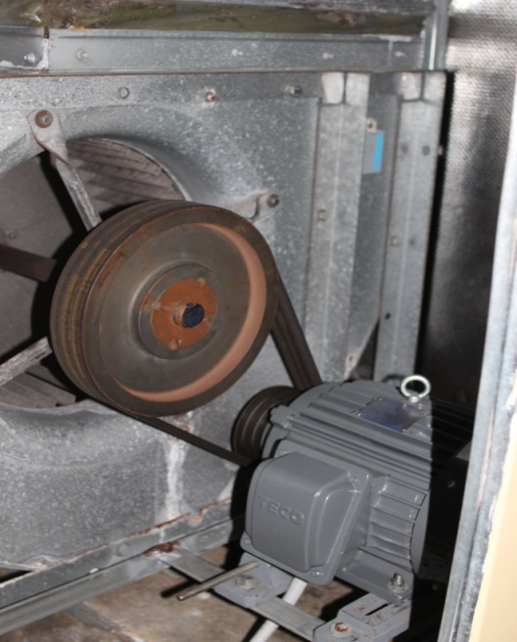
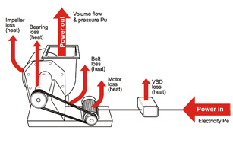
Isssues with Regular AC Belt Driven Fan
Regular maintenance cost for belts, pulleys, bearings, motor bearings, motor winding, etc..
High losses and power consumption
Belt dust – associated cost
Expensive and time consuming to fix

Slide 9
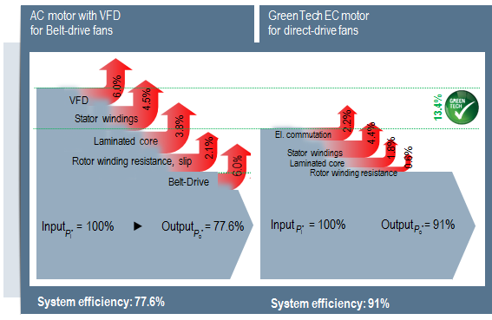
EC motor VS AC+VSD

Slide 10
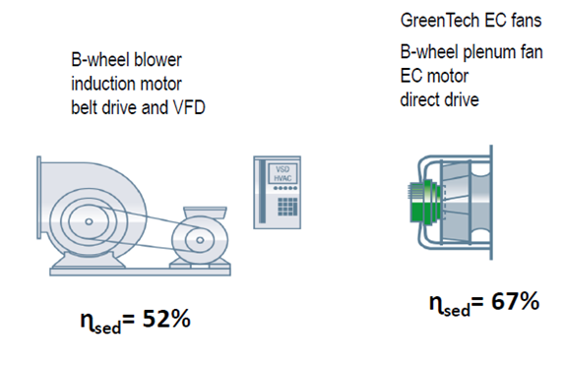
Overall Fan Efficiency EC VS AC
Comparison of fan systems by Measurement

Slide 11
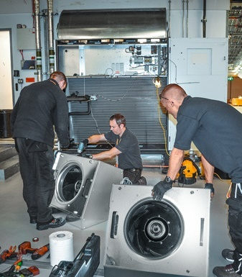
ECupgrades Examples in Hong Kong
Examples

Slide 12
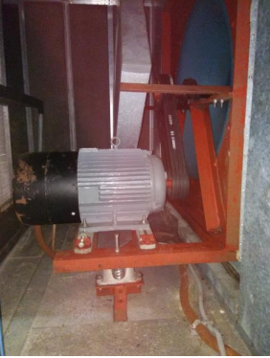
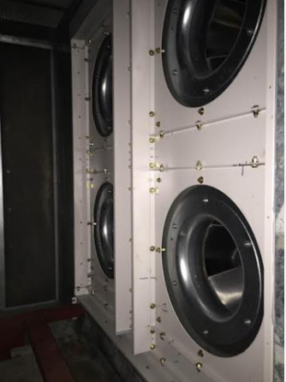
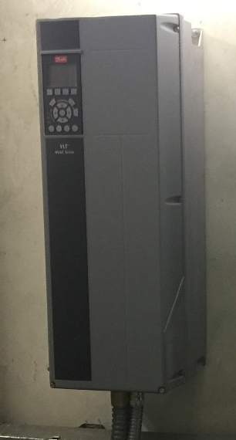
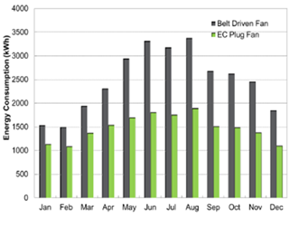
Commercial Building Case 1
EC Plug Fan
AC Belt Driven with external VFD
Measured Result: Saved 40% Energy Annually

Slide 13
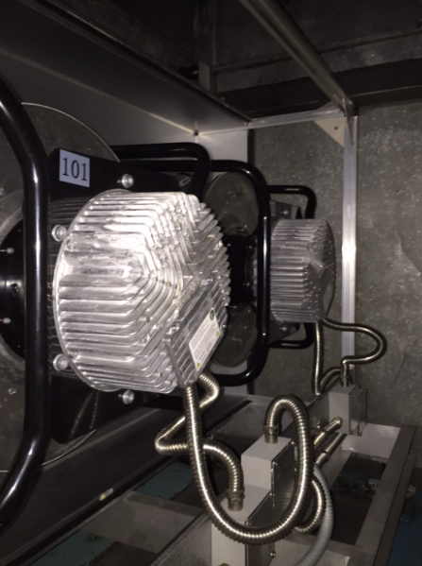
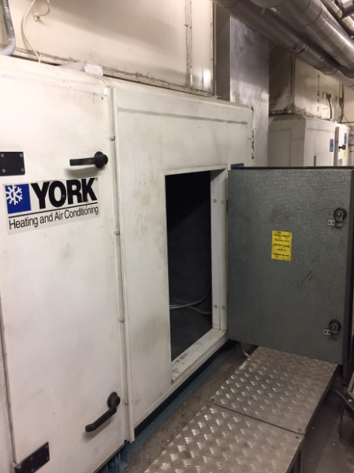
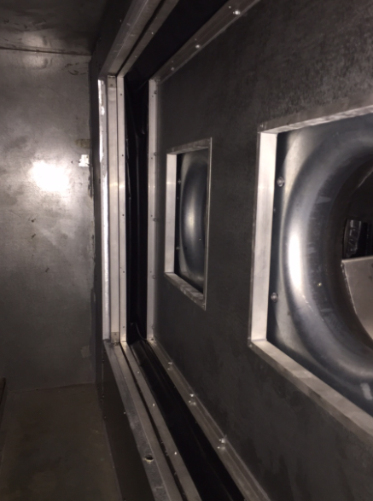
Commercial Building Case 2
Save 30% power consumption
10 kW to 7kW
Short retrofit time – 2 Days

Slide 14
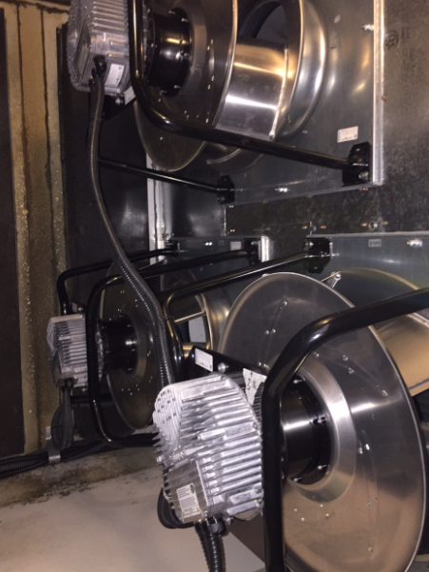
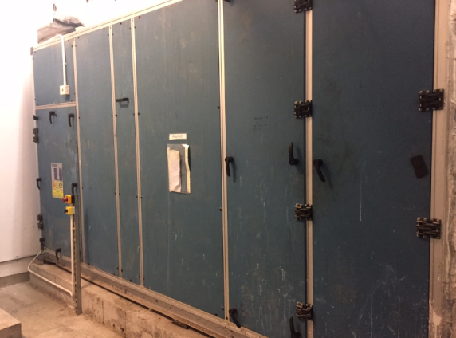
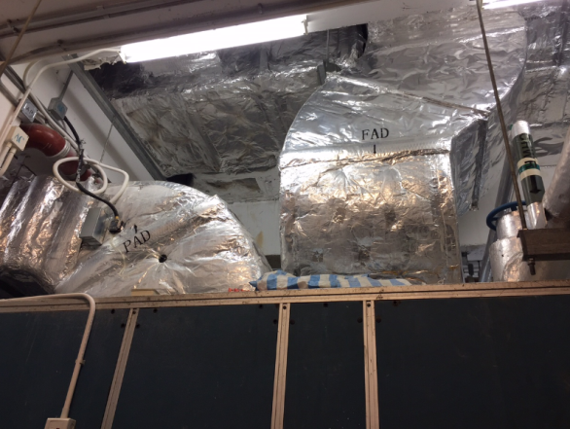
Casino
Save 40% power consumption
15 kW to 9kW
Short retrofit time – 2 Days

Slide 15
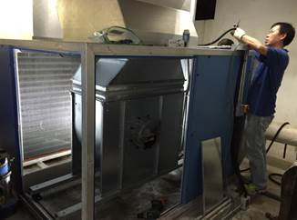
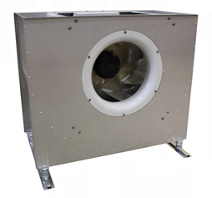
Office building
Save 50% power consumption
6.75 kW to 3.4kW
Short retrofit time – ONE Day

Slide 16
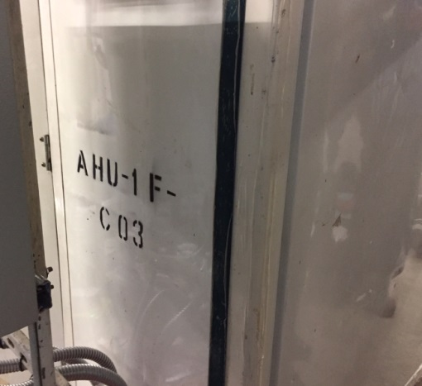
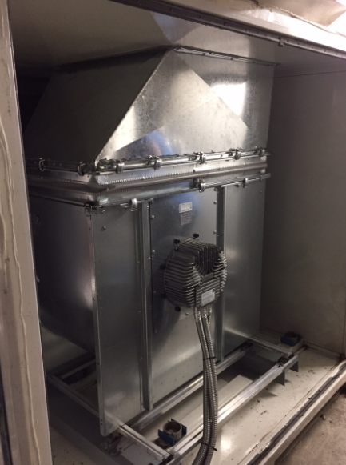
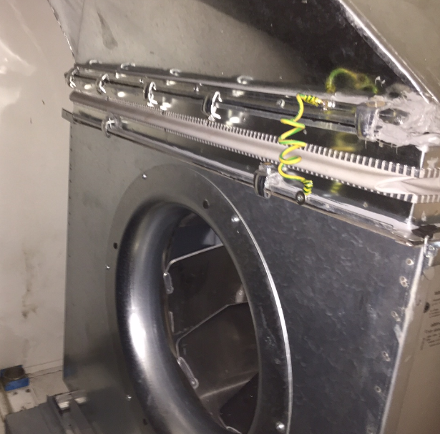
Shopping Mall Case
Save 35% power consumption
5kW to 3.2kW
Short retrofit time – 1 Day

Slide 17
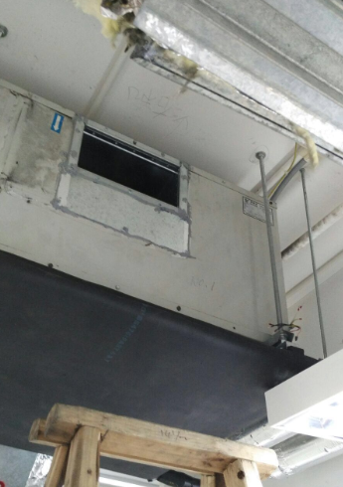
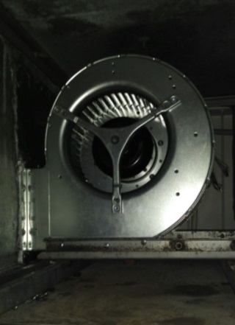
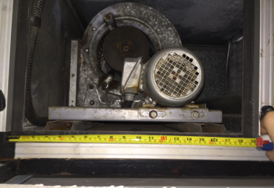
Office PAU
Save 50% power consumption
1kW to 0.49 kW
Short retrofit time – Half Day

Slide 18
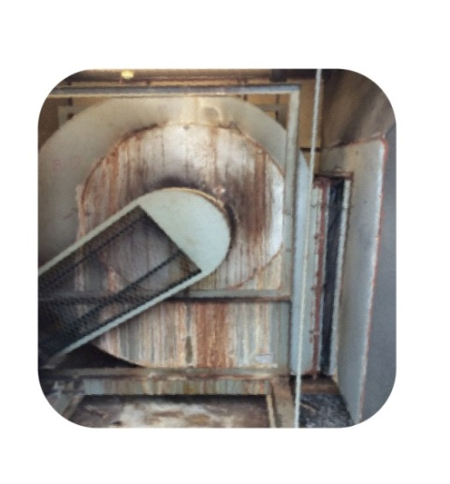
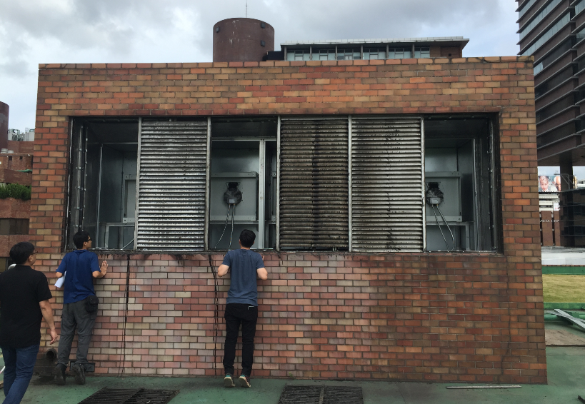
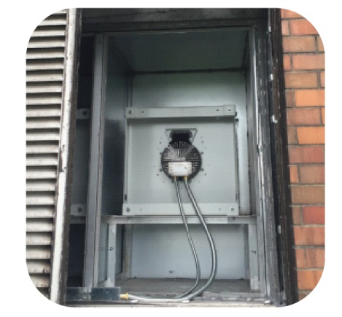
-Energy Saving: Consumed 43% LESS electricity than before
University Kitchen Ventilation EAF & FAF

Slide 19
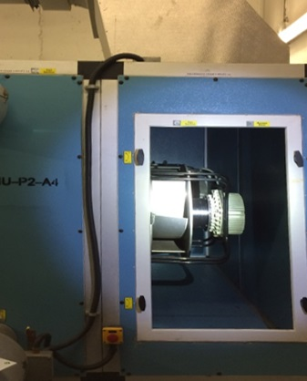
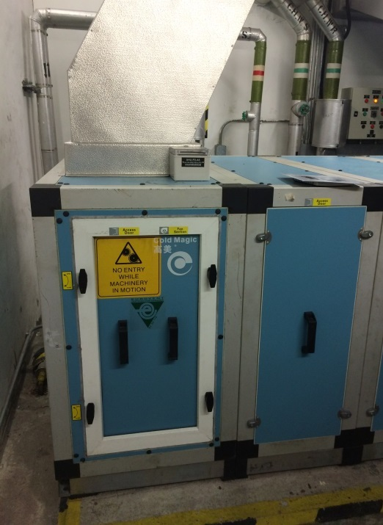
Government Office AHU
Exceptional Reliability: from 2010 to now
Maintenance free

Slide 20
Thank you
Clement Jim – EC Market Specialist

